Slide 1
Learning from Multi-domain Artistic Images for Arbitrary Style Transfer (ACM 2019)
Jongwook Si (M.S Course)
2021.06.18

Slide 2
Abstract
overview
Fast feed-forward network for style transfer
Learn Style from large-scale multi-domain artistic images
Use a conditional generator that stylized content (based on category of styles)
Propose a mask module

Slide 3
Introduction
overview
The trained images translation network
Can transfer image from one domain to another domain (natural to sketch)
Can’t be applied to arbitrary style transfer as input images are from multiple domains
Techniques to tackle the challenging problem
Conditional network (Both generator and discriminator)
AdaIN (to combine the two input)
Mask Module (to control the level of stylization)

Slide 4
Introduction
overview
Generator
Be trained to fool the discriminator
Satisfy the content and style representation similarity inputs
Be conditioned on both content image and style image
Use AdaIN
Discriminator
Be conditioned on the coarse domain categories
Be trained to distinguish the generated images with real images from the same style

Slide 5
Proposed Method
overview
Transformation network
ED architecture
Use the conv. Layers of the pretrained VGG
Add skip connection
Concatenate the features from different level
Be trained with perceptual loss for content representation

Slide 6
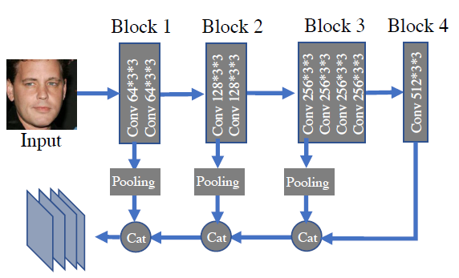
Proposed Method
Network architecture
Encoder (VGG)
Adapt first 3 blocks and the first conv. Layer of the forth block
Max-pooling layer of stride two between blocks
Concatenate the features from the first conv.
layer of each block as the output
Skip connection
To transfer style captured both high and low
Smooth the surface

Slide 7
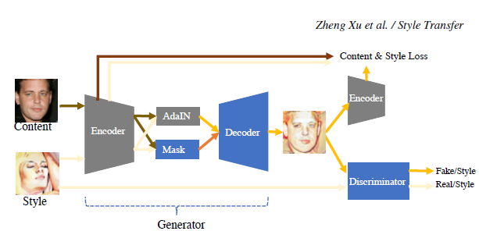
Proposed Method
Network architecture

Slide 8
Proposed Method
Network architecture
Decoder
Be designed to be almost symmetric to the VGG Encoder
Have four blocks
Transposed conv. layer for up-sampling
Add LeakyReLU and batch normalization

Slide 9
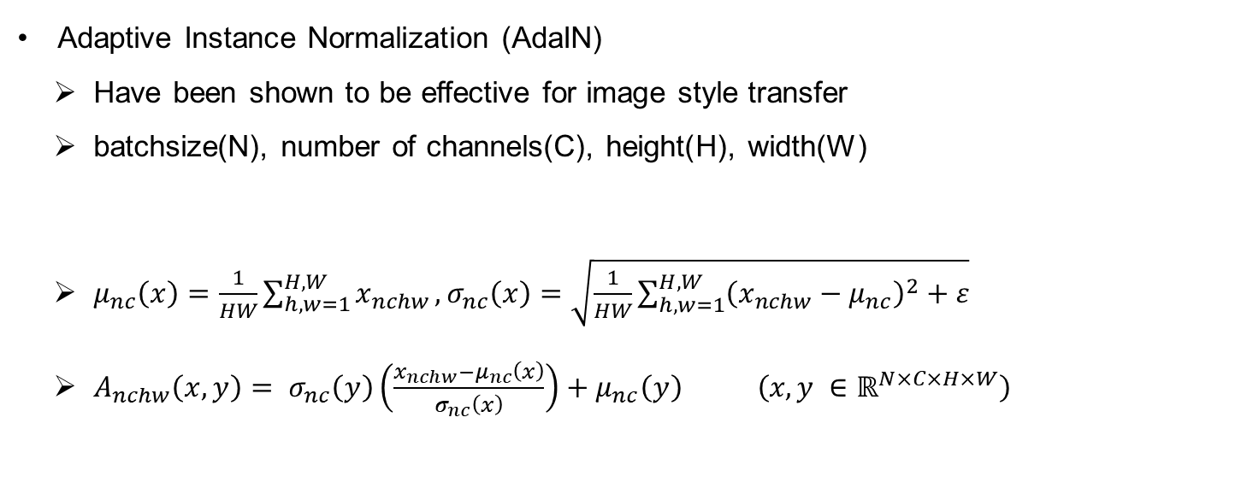
Proposed Method
Network architecture
Adaptive Instance Normalization (AdaIN)
Have been shown to be effective for image style transfer
batchsize(N), number of channels(C), height(H), width(W)
$μ_{nc}\left(x\right)=\frac{1}{HW}\sum_{h,w=1}^{H,W}{x_{nchw}},σ_{nc}\left(x\right)=\sqrt{\frac{1}{HW}\sum_{h,w=1}^{H,W}{{\left(x_{nchw}−μ_{nc}\right)}^{2}+ε}}$
$A_{nchw}\left(x,y\right)= σ_{nc}\left(y\right)\left(\frac{x_{nchw}−μ_{nc}\left(x\right)}{σ_{nc}\left(x\right)}\right)+μ_{nc}\left(y\right) \left(x,y ∈ℝ^{N×C×H×W}\right)$

Slide 10
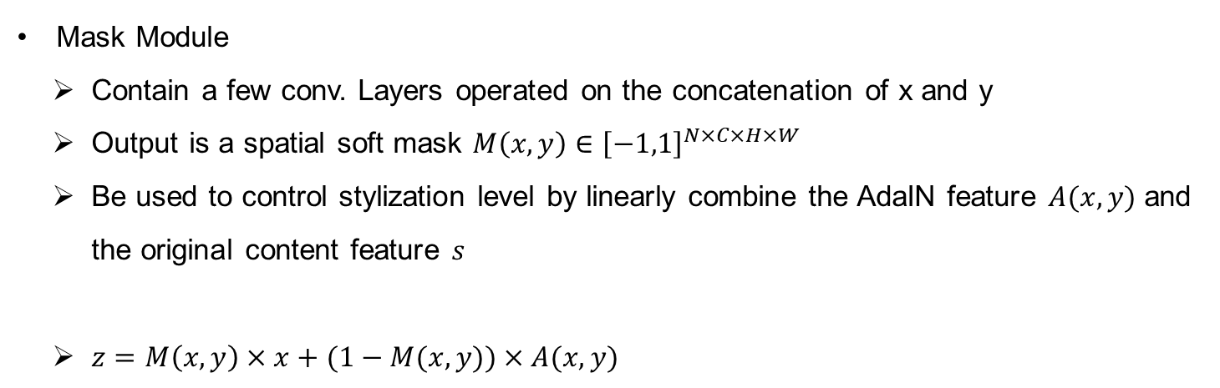
Proposed Method
Network architecture
Mask Module
Contain a few conv. Layers operated on the concatenation of x and y
Output is a spatial soft mask $M\left(x,y\right)∈{\left[−1,1\right]}^{N×C×H×W}$
Be used to control stylization level by linearly combine the AdaIN feature $A(x,y)$ and the original content feature $s$
$z=M\left(x,y\right)×x+(1−M(x,y))×A(x,y)$

Slide 11
Proposed Method
Network architecture
Discriminator
To handle the multi-domain image s for arbitrary style transfer, discriminator is conditioned on the style category labels
Predict the style category and distinguish the real image and fake image

Slide 12
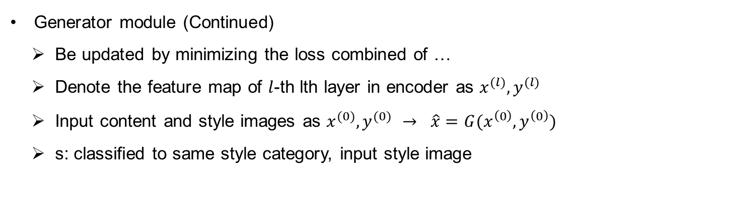
Proposed Method
Adversarial training
Generator module (Continued)
Be updated by minimizing the loss combined of …
Denote the feature map of $l$-th lth layer in encoder as $x^{(l)},y^{(l)}$
Input content and style images as $x^{(0)},y^{(0)}$ $→ \hat{x}=G(x^{\left(0\right)}, y^{\left(0\right)})$
s: classified to same style category, input style image

Slide 13
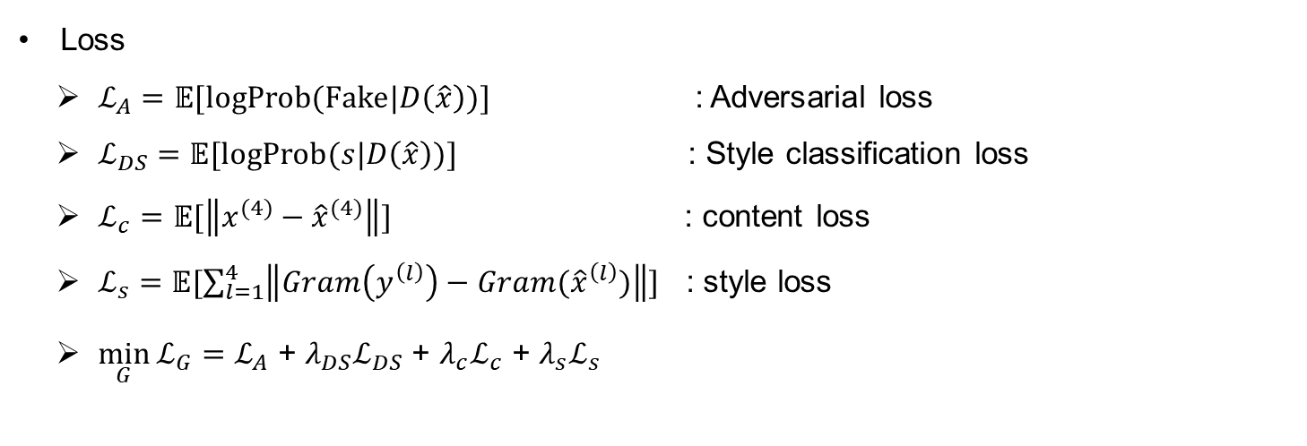
Proposed Method
Adversarial training
Loss
$ℒ_{A}=𝔼[logProb(Fake|D\left(\hat{x}\right))]$ : Adversarial loss
$ℒ_{DS}$ $=𝔼[logProb(s|D\left(\hat{x}\right))]$ : Style classification loss
$ℒ_{c}$ $=𝔼[\left\|x^{(4)}−{\hat{x}}^{(4)}\right\|]$ : content loss
$ℒ_{s}$ $=𝔼[\sum_{l=1}^{4}{\left\|Gram\left(y^{\left(l\right)}\right)−Gram({\hat{x}}^{\left(l\right)})\right\|}]$ : style loss
$\min_{G}{ℒ_{G}}=ℒ_{A}$ + ${λ_{DS}ℒ}_{DS}$ + $λ_{c}ℒ_{c}$ + $λ_{s}ℒ_{s}$

Slide 14
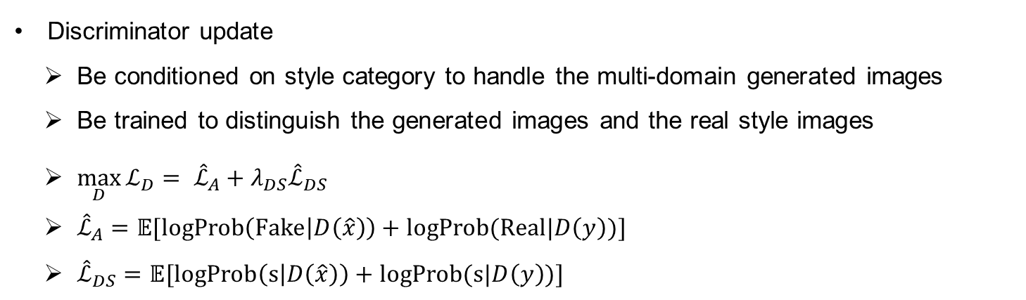
Proposed Method
Adversarial training
Discriminator update
Be conditioned on style category to handle the multi-domain generated images
Be trained to distinguish the generated images and the real style images
$\max_{D}{ℒ_{D}}= {\hat{ℒ}}_{A}+{λ_{DS}\hat{ℒ}}_{DS}$
${\hat{ℒ}}_{A}=$ $𝔼[logProb\left(Fake | D\left(\hat{x}\right)\right)+logProb(Real|D\left(y\right))]$
${\hat{ℒ}}_{DS}=$ $𝔼[logProb\left(s | D\left(\hat{x}\right)\right)+logProb(s|D\left(y\right))]$

Slide 15
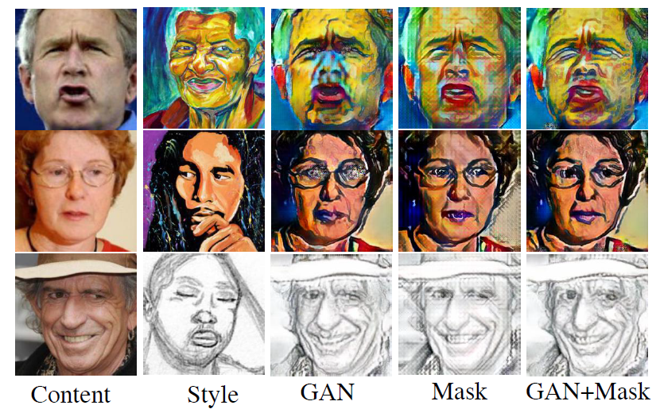
Proposed Method
Ablation study
Adversarial Training
Improve the visual quality
Remove block effect and artifacts
Make look more natural
Mask Module
Improve the stylization of face components
Prevent over stylization of region
Help adversarial training

Slide 16
Experiments
Ablation study
Behance Dataset
large-scale dataset of artistic images
Contains coarse category labels for content and style
Category: vector art, 3D graphics, comic, graphite, oil paint, pen ink and water color
Create subset : face (15,000), bird (5,000), car (5,000) and building (5,000)
Additional Dataset
CelebA, CaltechUCSE, Cars and Oxford building

Slide 17
Experiments
Ablation study
Total number of Data (Training/Testing)
Face : 122,247 / 11,325
Bird : 35,000 / 3,505
Car : 36,940 / 3,700
Building : 34,374 / 3,444
Detailed Values
Set weight as 1 except for style loss : 200

Slide 18
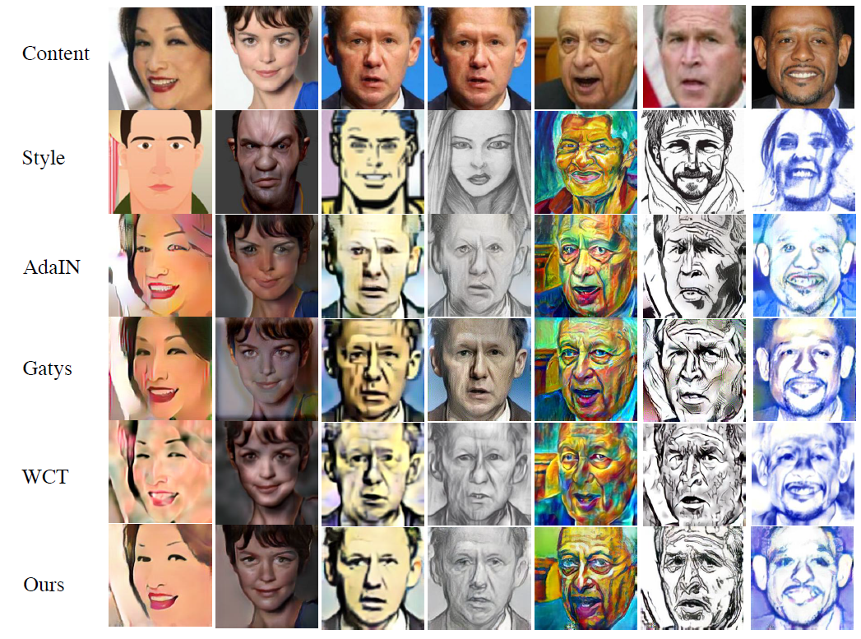
Experiments
Evaluation of style transfer

Slide 19
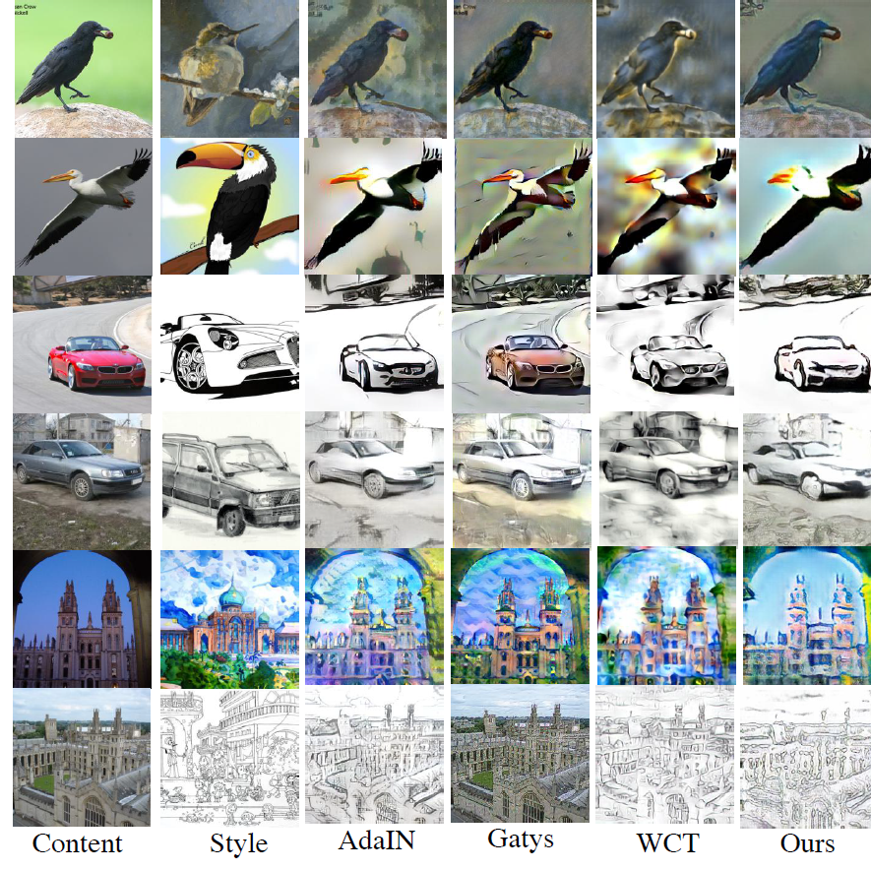
Experiments
Evaluation of style transfer for general object

Slide 20
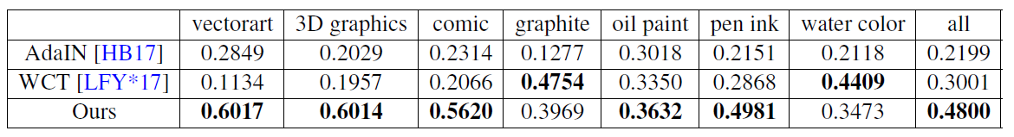
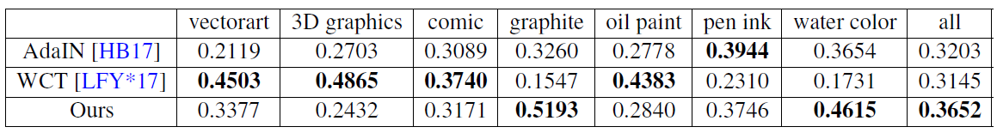
Experiments
Evaluation
Evaluation
Randomly select 10 content images and 10 style images
Generate 700 testing pairs
Ask 10 users to select the best results

